Slide 1
Basic SQL
SQL Day 1 Class

Slide 2
Learning Objectives
By the end of this lesson, you will be able to:
Define SQL, statement, and query
Use SELECT to work with values directly
Identify common string expressions in SQL
Understand how to write math expressions in SQL
Use SELECT to query fields from a table

Slide 3
What is SQL
SQL stands for Structured Query Language
Standard programming language for managing data in databases
Works with relational database management systems (RDBMS) like Oracle, MySQL, SQL Server, etc.

Slide 4
Key SQL Statements
SELECT - retrieve data from a database
INSERT - insert new data into a database
UPDATE - update existing data in a database
DELETE - delete data from a database
Other statements like CREATE, ALTER, DROP, etc. manage database objects

Slide 5
Features of SQL
Declarative language - specify what data you want, not how to get it
English-like syntax, easy to learn and use
Portable skill - can switch between database systems
Wide range of applications - web/mobile apps, analytics, ETL, etc.
In-demand skill for jobs involving databases

Slide 6
Why Learn SQL?
Essential for many technology roles:
Database Administrators
Data Analysts
Data Engineers
Application Developers
Understanding SQL enables working with data-driven systems
Opens up opportunities in fields leveraging databases
Valuable addition to technical skill set

Slide 7
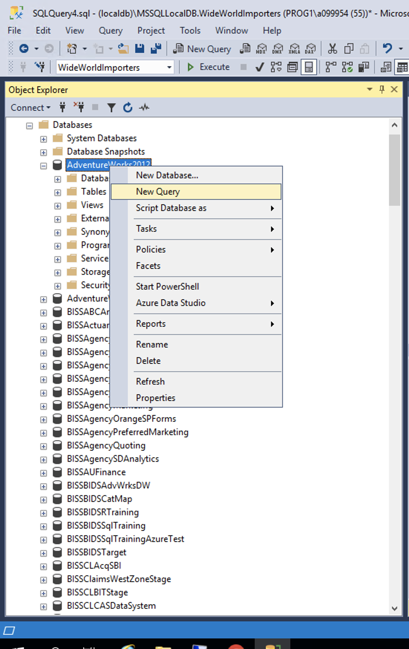
Prep
Using the World Wide Importers Database
Please open up SSMS
Connect to BISS
mss-p1-biss-01
Right click on AdventureWorks2012
Select new query

Slide 8
Working with Strings
What are strings?
Text values in single quotes
VARCHAR, CHAR, TEXT data types
Examples:
'John'
'This is a string'

Slide 9
Key Functions and Operations
LEN(string)
Returns length
Example: SELECT LEN('hello’) ;
returns 5
Concatenation with +
'John' + ' ' + 'Doe'
Returns 'John Doe'
STRING_SPLIT()
Split by delimiter
Example: SELECT * FROM STRING_SPLIT('x,y,z', ', ‘);
Returns table with values x, y, z

Slide 10
Patterns & Matching
PATINDEX()
Returns start position of pattern
Example:
SELECT PATINDEX('%w%', 'Hello world’);
returns 7
REPLACE()
Replace occurrences of string
Example: SELECT REPLACE('Hello World', 'World', 'Universe’) ;
Returns 'Hello Universe'

Slide 11
In Summary
Key Takeaways:
Many built-in functions for text manipulation
Flexible pattern matching capabilities
Integrates well with other SQL operations

Slide 12
Math Operators
Basic arithmetic in SQL uses operators:
Addition (+) Adds two numbers together.
Subtraction (-) Subtracts the second number from the first number.
Multiplication (*) Multiplies two numbers.
Division (/) Divides the first number by the second number
Calculate values in queries:
SELECT 10 + 5;
Returns 10
Select 12 / 6
Returns 2

Slide 13
Integer Data Type
The Integer data type is used to store whole numbers without fractions.
Some key details:
Integers represent exact numerical values without decimals.
Commonly used for counts, identifiers, sequence numbers, rankings etc.
Features:
Exact values without decimals
Limited range +/- 2 billion typically
Less storage than high precision decimals
Faster computations than decimals

Slide 14
Integer Data Type
Declaration:
DECLARE @count INT
Sets @count as integer variable for reuse
Usage Example:
DECLARE @students INT;
SET @students = 350;
SELECT @students / 5;
Returns 70
Performs integer division to get number of groups of 5 students.
Integer type provides efficient storage & processing for non-fractional numbers.

Slide 15
Decimal Data Type
Decimals store fractions up to a precision.
Decimals store numbers with fractions & high precision.
Useful for:
Currency values
Scientific data
Stats with weights
Features:
Fixed scale (decimals) & precision
Up to 38 digits typically
Accuracy for high precision data
Avoid rounding errors

Slide 16
Decimal Data Type
Declaration:
DECLARE @price DECIMAL(10,2)
10 total digits with 2 decimal places.
Usage Example:
DECLARE @weight DECIMAL(8,3);
SET @weight = 5.555;
SELECT @weight + 2.222;
returns 7.777
Retains 3 decimal places of precision during calculation.
Decimal type handles high accuracy fractional data without rounding issues.

Slide 17
Mixing Types
SQL allows seamless usage of both integers and decimals together in numeric expressions and calculations.
How it works:
SQL converts between data types automatically where needed during computations.
Rules:
Integer + Decimal → Decimal
Decimal + Integer → Decimal
Conversions retain maximum precision

Slide 18
Mixing Types
Declaration:
DECLARE @int INT = 5;
DECLARE @dec DECIMAL(10,2) = 4.5;
SELECT @int + @dec
returns 9.5
Integer converted to decimal for accurate mixed calculation.
SELECT CONVERT(INT, @dec)
returns 4
Conversion to integer truncates decimal portion.
Key Takeaway: Mixing ints & decimals provides flexibility in calculations!

Slide 19
Common Math Functions
SQL provides many built-in math functions that extend the calculation capabilities beyond the basic operators.
Common Math Functions:
ROUND() - Rounds a decimal value to x places
SQRT() - Returns square root of a number
ABS() - Absolute value
RAND() - Random number generation
Trigonometric like SIN(), COS(), TAN() etc
LOG10()/LOG()
And many more

Slide 20
Common Math Functions
Examples:
Select ROUND(3.14159, 3);
returns 3.142 Rounds decimal number to 3 places
Select SQRT(81);
returns 9
Select ABS(-10);
Returns 10 (Absolute value)
Select RAND();
Returns 0.879632 (Random decimal number)
This allows SQL to handle common & advanced mathematical computations required for statistics, analysis, science and engineering use cases.

Slide 21
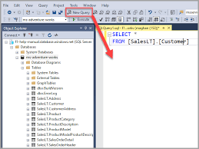
DML Statements
Manipulate Database Records & Data
Written in strings and end in semicolon
Not case sensitive
Visual Editor Ex: SQL Server Management Studio:

Slide 22
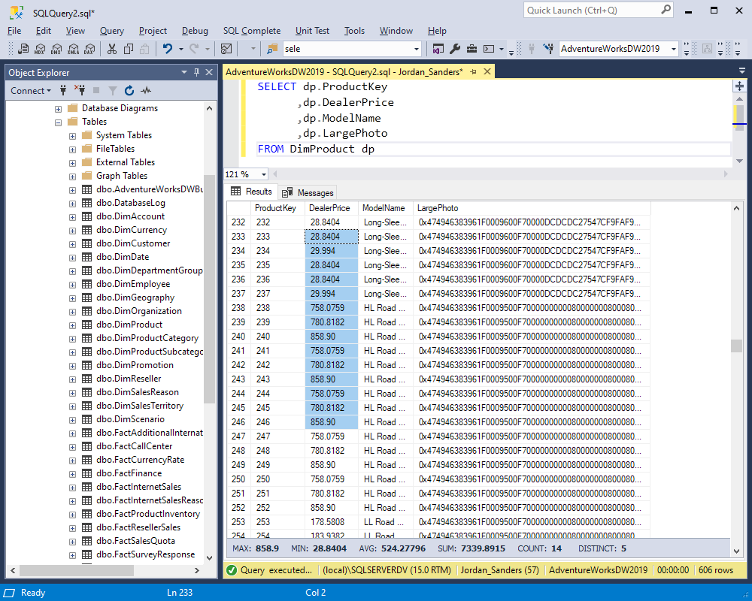
Select Statement
Retrieve Matching Record sets
Filtering, Projections & Joins
Examples:
SELECT * FROM students;
SELECT name, grade FROM students WHERE grade > 3.5;

Slide 23
Main Types
Main types:
DDL (Data Definition) - CREATE, ALTER, DROP - define schema
Example: CREATE TABLE students (id INT, name VARCHAR(50))
DML (Data Manipulation) - SELECT, INSERT, UPDATE, DELETE - query & change data
Example: SELECT * FROM students
DCL (Data Control) - GRANT, REVOKE - control access
Transactions - COMMIT, ROLLBACK - manage transactions

Slide 24
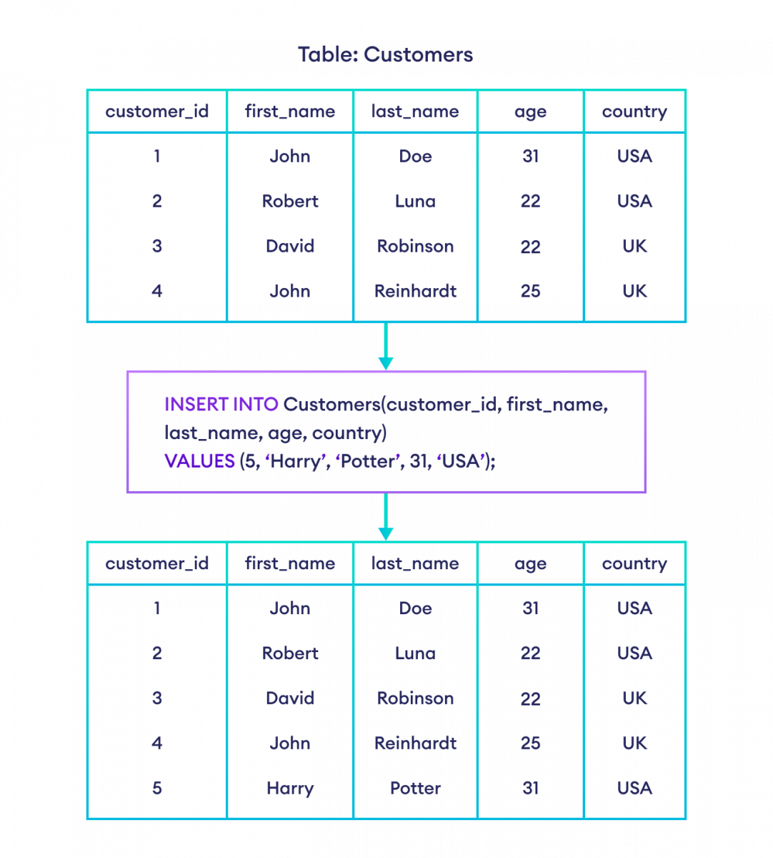
Insert Statement
Add New Records
Insert Data Rows into Tables
Examples:
INSERT INTO students (name, grade) VALUES ('Anna', 4.0);
INSERT INTO students VALUES (4, 'Mike', 3.8);

Slide 25
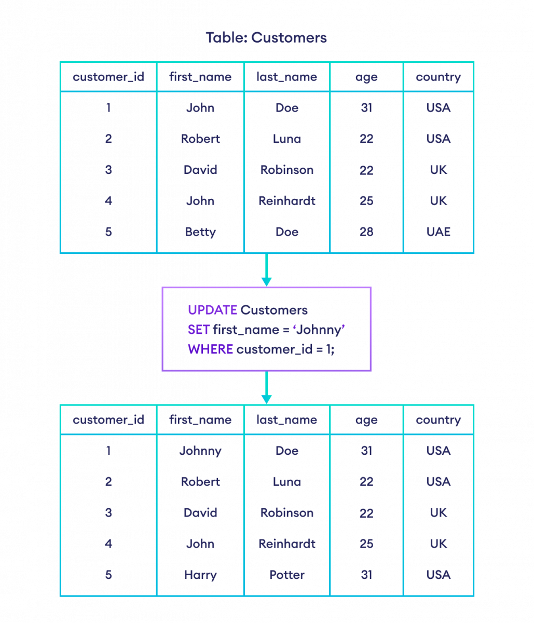
Update Statement
Edit & Modify Records
Change/Update Information
Examples:
UPDATE students SET grade = 4.2 WHERE name = 'Mike';
UPDATE students SET name = 'Michael' WHERE id = 4;

Slide 26
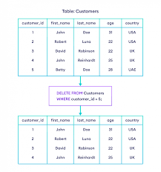
Delete Statement
Remove Records
Delete Obsolete/Unwanted Data
Example:
DELETE FROM students WHERE grade < 3.5;

Slide 27
SQL Statements
SQL is written in statements - strings of characters that conform to formatting and syntax rules specified in the international standard
For example, a basic SELECT statement fetching data from a Customers table would be:
SELECT id, name, address
FROM Customers
WHERE state = 'CA’
ORDER BY name;

Slide 28
SQL Statements
Writing an SQL statement involves:
Specify the operation type:
This includes statements like SELECT, INSERT, UPDATE, DELETE. This tells the database engine what you want to do - query data, insert new data, update existing data, or delete data.
SELECT id, name, address
FROM Customers
WHERE state = 'CA’
ORDER BY name;

Slide 29
SQL Statements
Writing an SQL statement involves:
Specify the table and columns:
The statement needs to indicate from which database table and columns you want to access or operate on. Often this is done after the operation type using a FROM clause.
SELECT id, name, address
FROM Customers
WHERE state = 'CA’
ORDER BY name;

Slide 30
SQL Statements
Writing an SQL statement involves:
Specify any filtering conditions (optional):
You can filter which data rows you want using a WHERE clause and conditional logic.
SELECT id, name, address
FROM Customers
WHERE state = 'CA’
ORDER BY name;

Slide 31
SQL Statements
Writing an SQL statement involves:
Specify sorting/grouping (optional):
Statements like ORDER BY and GROUP BY can control row sorting and grouping in the output.
SELECT id, name, address
FROM Customers
WHERE state = 'CA’
ORDER BY name;

Slide 32
SQL Statements
Writing an SQL statement involves:
End with a semicolon:
All SQL statements are terminated with a semicolon ";"
SELECT id, name, address
FROM Customers
WHERE state = 'CA’
ORDER BY name;

Slide 33
Querying Tables
SELECT retrieves data from database tables.
Basic syntax is:
SELECT column1, column2 FROM table_name;
Rules:
Specify table name after FROM
Choose column names to return after SELECT
Enclose names in square brackets [ ]
The square brackets [ ] around object names like table and column identifiers in the SQL queries are being used to delimit identifiers in case they contain special characters or spaces.
By default, SQL only allows alphanumeric characters and underscores in identifiers. Anything else like spaces, dashes etc would generate an error.

Slide 34
Querying Tables
Example using AdventureWorks:
SELECT [JobTitle], [VacationHours], [SickLeaveHours]
FROM [HumanResources].[Employee]
WHERE [VacationHours] > 40;
Gets Job Title, Vacation & Sick Hours
For employees with over 40 vacation hours

Slide 35
Querying Tables
Example using AdventureWorks:
SELECT [Name], [Color], [ListPrice] FROM [Production].[Product]
WHERE [ListPrice] < 100;
Retrieves Name, Color and ListPrice columns
Filters for products with ListPrice under 100
Encloses identifiers in brackets

Slide 36
Querying Tables
Selecting All Columns
The * shorthand after SELECT retrieves all columns in a table.
For example:
SELECT * FROM Production.Product;
Rules:
expands to all available columns
Avoid if only few columns needed
Can impact performance on large tables

Slide 37
Querying Tables
Why didn’t we use brackets?
The reasons:
The Production.Product table names don't have any special characters or spaces that require the square bracket delimiters.
Using SELECT * returns all columns so no need to enclose specific column names that may contain special characters.
follows normal SQL identifier rules - uses alphanumeric and underscore only. No brackets needed to avoid errors.
For consistency and safety, it is generally good practice to always enclose SQL object names in square brackets like:
[Production].[Product]

Slide 38
Querying Tables
Limiting Rows
The TOP N clause restricts number of rows returned.
For example
SELECT TOP N * FROM table;
Rules:
N specifies number of rows
TOP without N gets top %-age based on selects

Slide 39
Querying Tables
Examples on Production.Product:
Return first 10 products:
SELECT TOP 10 * FROM Production.Product;
Retrieves top 10 rows only
Get top 5 % products over $50:
SELECT TOP 5 PERCENT *
FROM Production.Product
WHERE ListPrice > 50;
Returns top 5 percent of matching rows
TOP reduces result size. Useful when sample data needed or avoid overloading.

Slide 40
Querying Tables
Column Aliases
Aliases temporarily rename columns during query.
For example:
SELECT column_name AS alias_name FROM table;
Rules:
Alias names after AS keyword
Alias used in final output
Does not change schema

Slide 41
Querying Tables
Examples on Production.Product:
Get product name and list price:
SELECT Name AS Product, ListPrice AS [Sale Price]
FROM Production.Product;
Aliases columns to descriptive names
Sale Price uses spaces to show brackets
So aliases improve readability without altering table structures.

Slide 42
Querying Tables
Additional Alias Example on ProductCategory:
Get product name and list price:
SELECT ProductCategoryID AS CategoryID, Name AS CategoryName, rowguid AS Identifier
FROM Production.ProductCategory;
Features:
Aliases CategoryID, CategoryName and rowguid columns
Descriptive names improve readability
Underlying schema unchange

Slide 43
Parsing Strings
Why String Parsing is Helpful
Extract parts of unstructured text data for analysis
Pattern recognition within strings
Identify trends based on common text patterns
Qualify string data to filter datasets
Render text data more readable
String manipulations for data pipelines
Redact sensitive values in reporting
Parse semi-structured data like csv files

Slide 44
Parsing Strings
Examples of Parsing Use Cases:
Get first letter of names for groupings
Check if phone numbers or zip codes are valid formats
Anonymize account numbers for reporting
Analyze most common word patterns in comments
Identify common misspellings in address data
In summary, string parsing functions enable deeper text analysis and transformations for business needs.

Slide 45
Parsing Strings
Left Function
LEFT(string, number_of_chars)
returns the specified leftmost number of characters from a string.
For example:
SELECT LEFT(FirstName, 1) FROM Person.Person;
This extracts the first letter from each person's FirstName value.
Can also be used in a WHERE clause:
SELECT FirstName FROM Person.Person
WHERE LEFT(FirstName, 1) = 'J';
The above gets first names starting with letter 'J'.

Slide 46
Parsing Strings
Right Function
RIGHT(string, number_of_chars)
returns the specified rightmost number of characters from a string.
For example:
SELECT RIGHT(LastName, 3) FROM Person.Person;
This extracts the rightmost 3 letter from each person’s LastName value.
Can also be used in a WHERE clause:
SELECT LastName FROM Person.Person
WHERE RIGHT(LastName, 2) = 'on';
The above gets last names ending in ‘on’

Slide 47
Parsing Strings
Substring Function
SUBSTRING(string, start_position, length)
extracts a substring from a string starting at the specified position for the specified length.
For example:
SELECT SUBSTRING(FirstName, 2, 2) FROM Person.Person;
This extracts 2 characters starting from position 2 of each FirstName value.
Can also be used in a WHERE clause:
SELECT FirstName FROM Person.Person
WHERE SUBSTRING(FirstName,1,1) = 'M';
The above gets first names starting with letter M.

Slide 48
Parsing Strings
CharIndex Function
CHARINDEX(substring, string)
locates specified substrings within text.
Useful for search and matching patterns in strings.
For example:
SELECT CHARINDEX('a',FirstName) FROM Person.Person;
This finds the first match position of letter 'a' within each FirstName value.
Can also be used in a WHERE clause:
SELECT FirstName FROM Person.Person
WHERE CHARINDEX('ey',FirstName) > 0;
The above extracts first names containing substring 'ey'.

Slide 49
Parsing Strings
PatIndex Function
PATINDEX ('%pattern%', string)
returns the first match position of a pattern with wildcards.
For example:
SELECT PATINDEX('%a%',FirstName) FROM Person.Person;
% wildcard looks for 'a' anywhere in string
Returns first match position
Can also be used in a WHERE clause:
SELECT FirstName FROM Person.Person
WHERE PATINDEX('[aA]%',FirstName) = 1;
The above filters names starting with A or a

Slide 50
Summary
SQL Data Querying - Best Practices
SQL enables powerful data retrieval & manipulation
Flexible data access across tables
Optimization for fast performance
Tips for Efficiency:
Focus queries only on required columns and conditions
Look for inefficient scans or expensive operators
Improve Over Time:
Start simple and targeted, add complexity gradually
Validate results at each iteration
Benchmark and baseline for improvements
Practice makes efficient SQL use

Slide 51
Exercise
Introduction: AdventureWorks Sample Database
Includes data for fictitious bike manufacturer
Widely used to demonstrate SQL Server examples
We will query and analyze some AdventureWorks tables
Instructions: Follow the steps outlined in each section. Use built-in help and intellisense at any step if needed.

Slide 52
Exercise
Section 1: Simple Data Retrieval
Connect to AdventureWorks sample database
Retrieve FirstName, LastName from Person.Person table
Select only first 10 rows
Alias FirstName as "First Name"

Slide 53
Exercise
Section 1: Simple Data Retrieval
Connect to AdventureWorks database
Use SQL Server Object Explorer
Find AdventureWorks sample database
Retrieve FirstName and LastName:
SELECT FirstName, LastName FROM Person.Person;
Select first 10 rows only:
SELECT TOP 10 FirstName, LastName FROM Person.Person;
Alias the FirstName column:
SELECT TOP 10 FirstName AS [First Name], LastName FROM Person.Person;

Slide 54
Exercise
Section 2: Filtering Data
Retrieve JobTitle, VacationHours, and SickLeaveHours from HumanResources.Employee
Only include JobTitle = 'Design Engineer’
Sort result-set alphabetically by LastName

Slide 55
Exercise
Section 2: Filtering Data
Retrieve columns - FirstName, LastName, JobTitle
SELECT JobTitle, VacationHours, SickLeaveHours FROM HumanResources.Employee
Filter where Job Title is Design Engineer:
SELECT JobTitle, VacationHours, SickLeaveHours FROM HumanResources.Employee WHERE JobTitle = 'Design Engineer’;
Sort alphabetically by LastName:
SELECT JobTitle, VacationHours, SickLeaveHours FROM HumanResources.Employee WHERE JobTitle = 'Design Engineer' ORDER BY VacationHours DESC;

Slide 56
Exercise
Section 3: Text Manipulation
From Person.Person get FirstName and LastName
Extract first letter of FirstName using LEFT
Get last 3 letters of LastName with RIGHT
Combine extracted pieces with concatenation

Slide 57
Exercise
Section 3: Text Manipulation
Select FirstName and LastName columns:
SELECT FirstName, LastName FROM Person.Person;
Extract first letter from FirstName with LEFT:
SELECT LEFT(FirstName, 1) AS [First Initial], LastName FROM Person.Person;
Get last 3 chars of LastName with RIGHT:
SELECT LEFT(FirstName, 1) AS [First Initial], RIGHT(LastName, 3) AS [Last 3 Chars] FROM Person.Person;
4. Combine extracted pieces:
SELECT LEFT(FirstName, 1) + ' ' + RIGHT(LastName, 3) AS Name FROM Person.Person

Slide 58
Exercise
Summary Discussion:
What challenges did you face?
What SQL concepts were unclear?
Ideas to improve the instructional flow?

